Slide 1
Owl Robot
Anhar Risnumawan

Slide 2
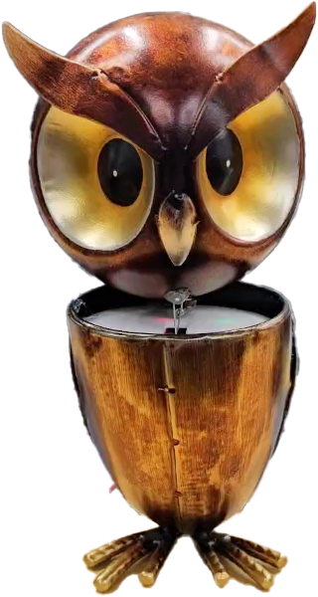
Owl Robot Overview
Nodding motion
Vibrate
Owl hooting sound

Slide 3
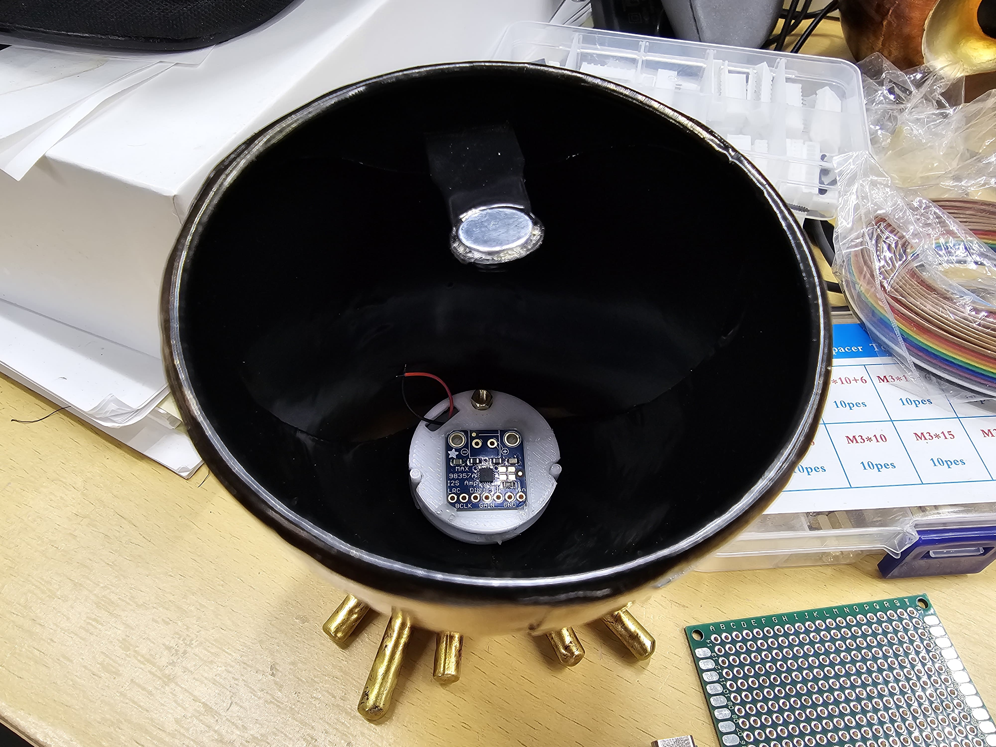
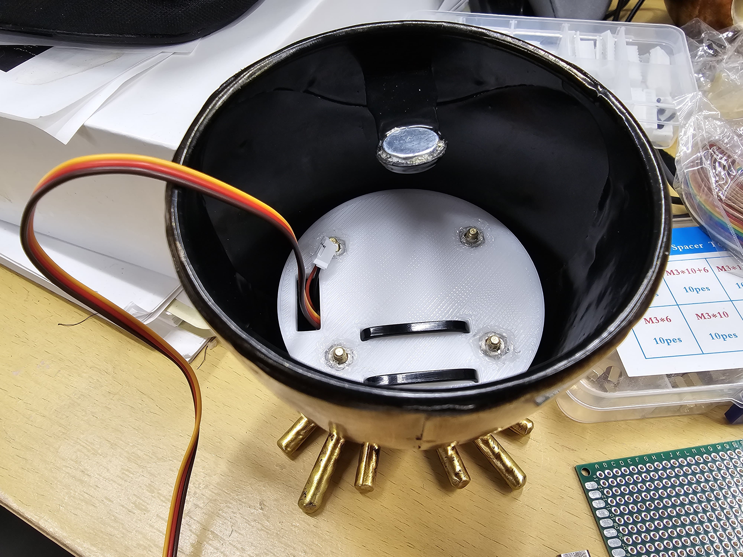
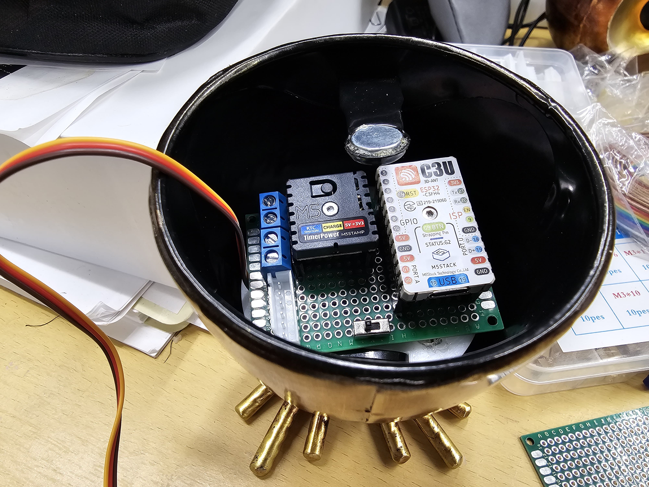
Stacked Hardware
Speaker and amplifier (Left)
Battery, servo motor, mini vibration motor (Middle)
Main controller: m5stamp c3u, timer power module, and other circuitries (Right)

Slide 4
Electrical Diagram

Slide 5
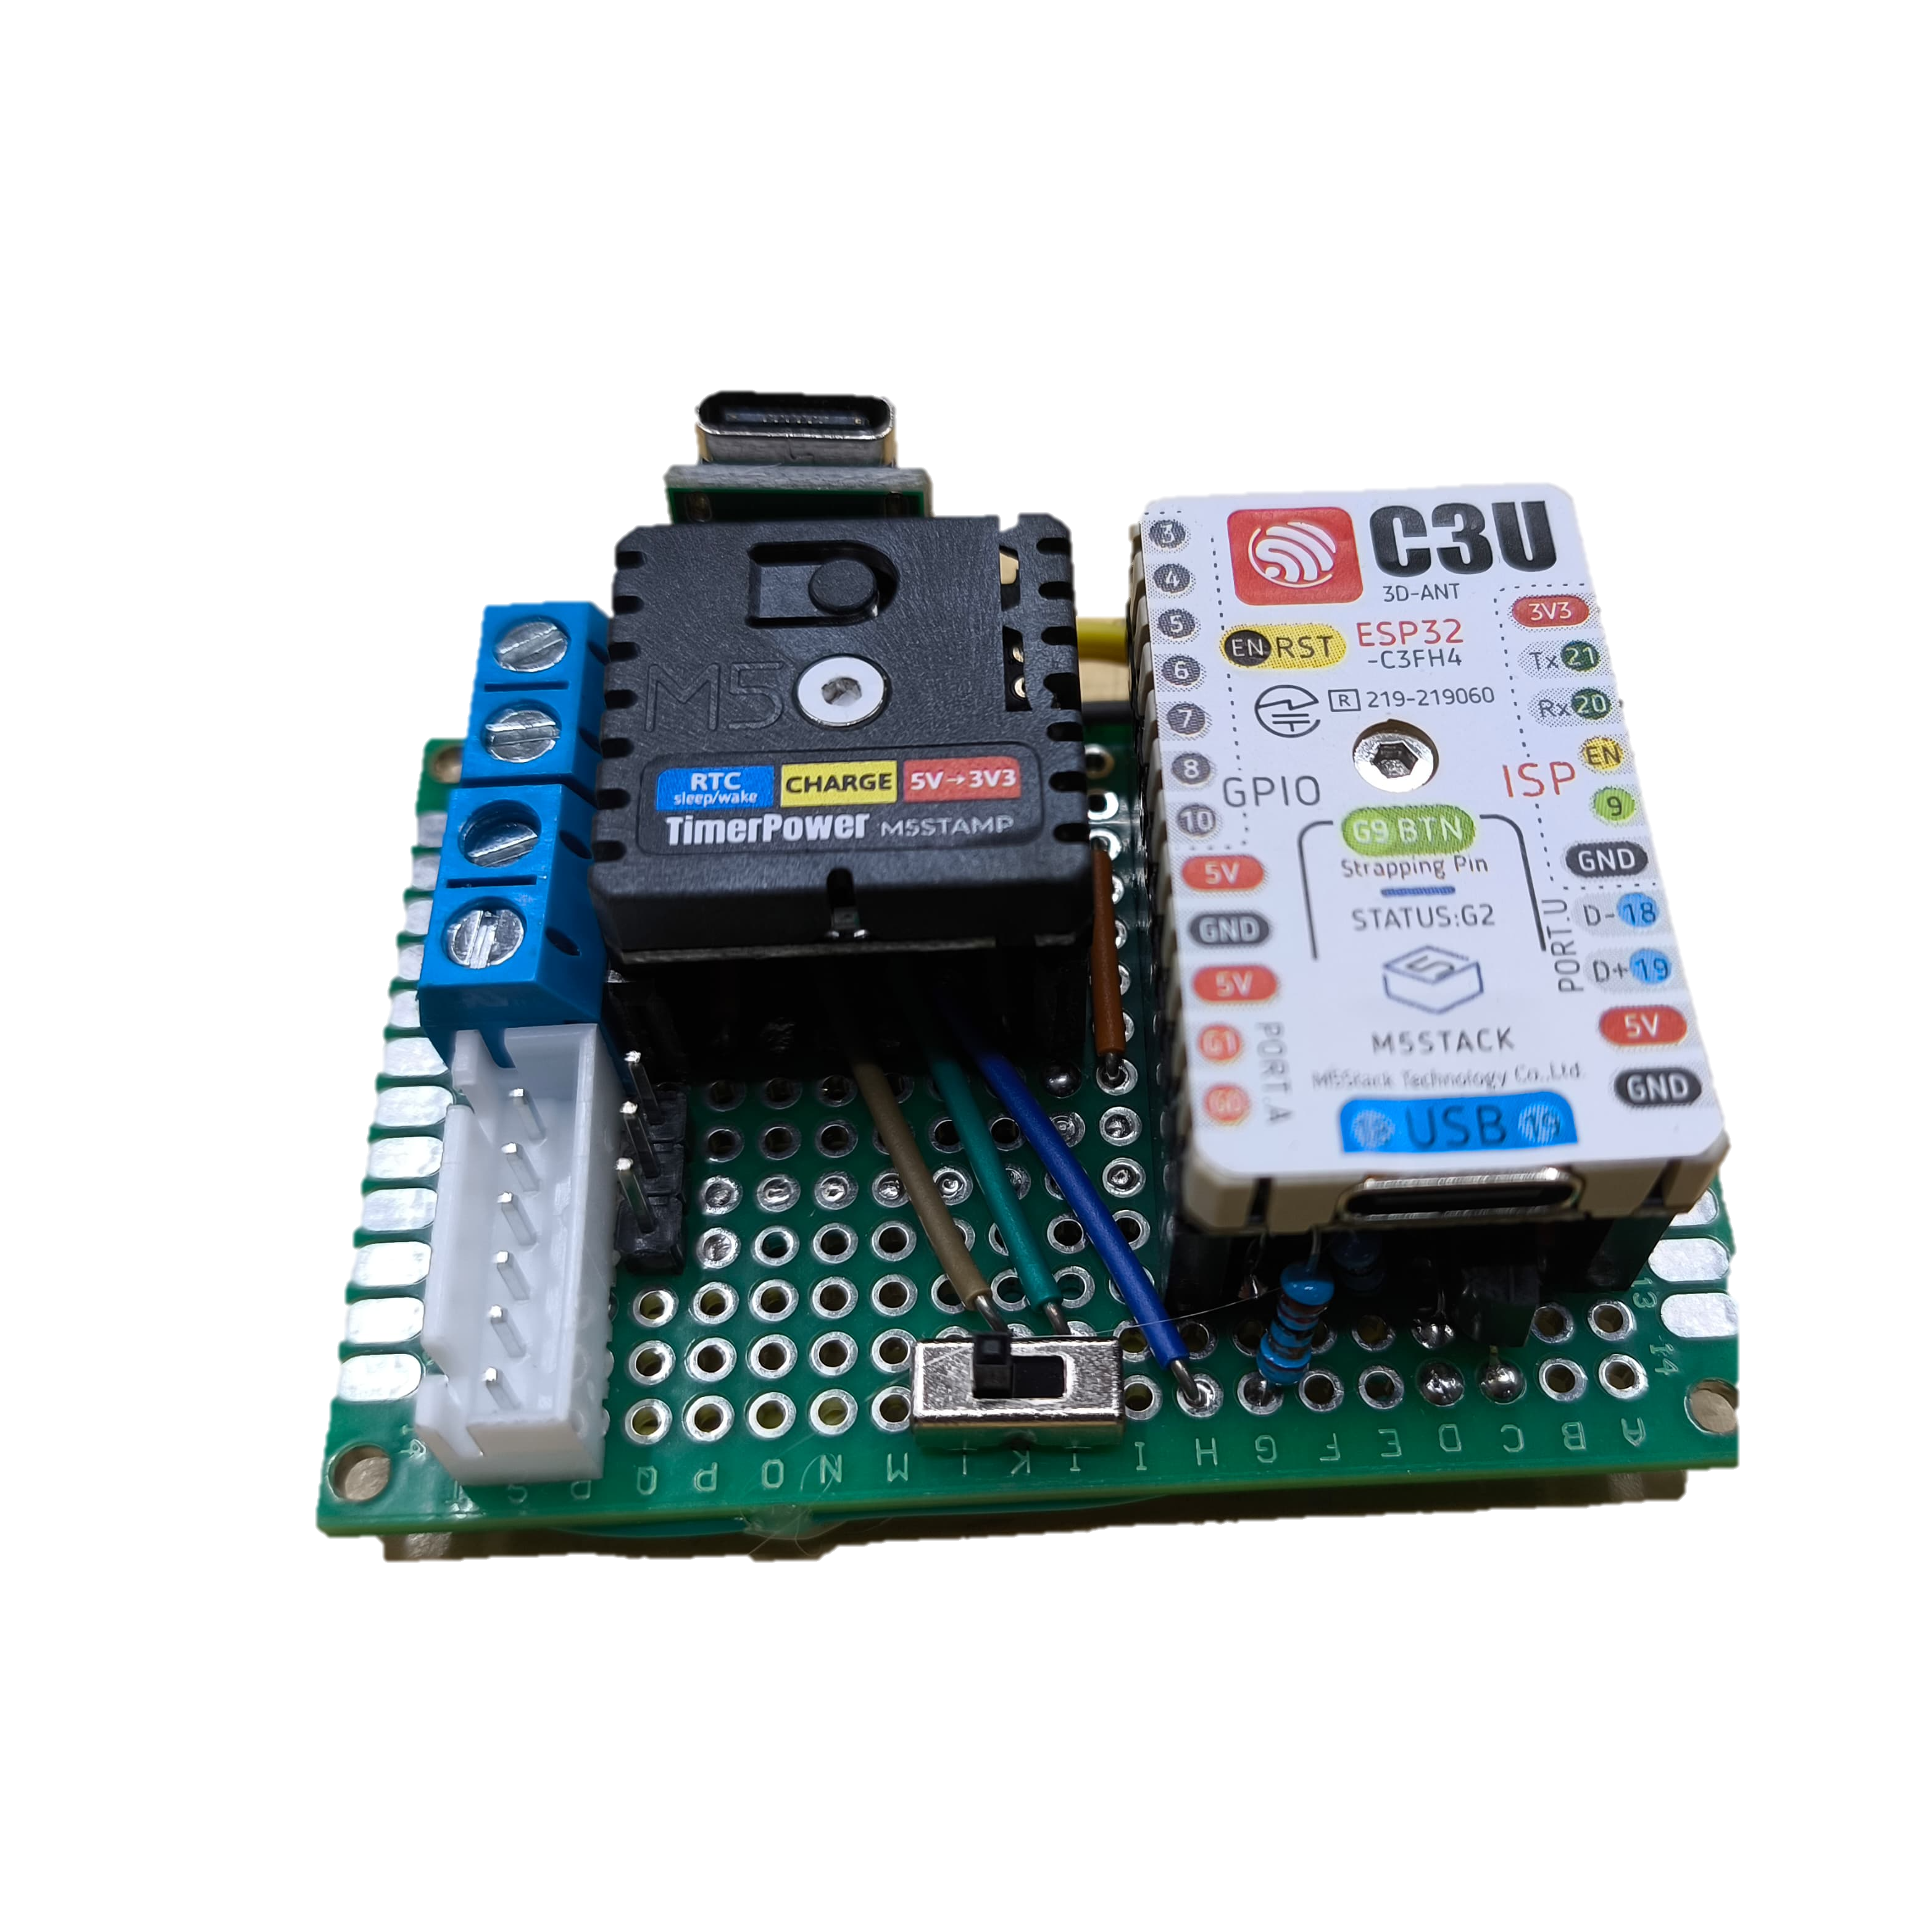
Top Layer
USB type C
For Charging
Power
Reset
Mini Vibration
Motor
Pin from top-to-bottom
Mini vibration motor
Power motor +3.7v
Power motor –
Lipo Battery
+3.7v
-
Servo
-
+5v
Pwm
Speaker
-
+5v
Not used
LRC
BCLK
DIN
LiPo Battery
Servo
Upload
Program
Speaker
Power Switch

Slide 6
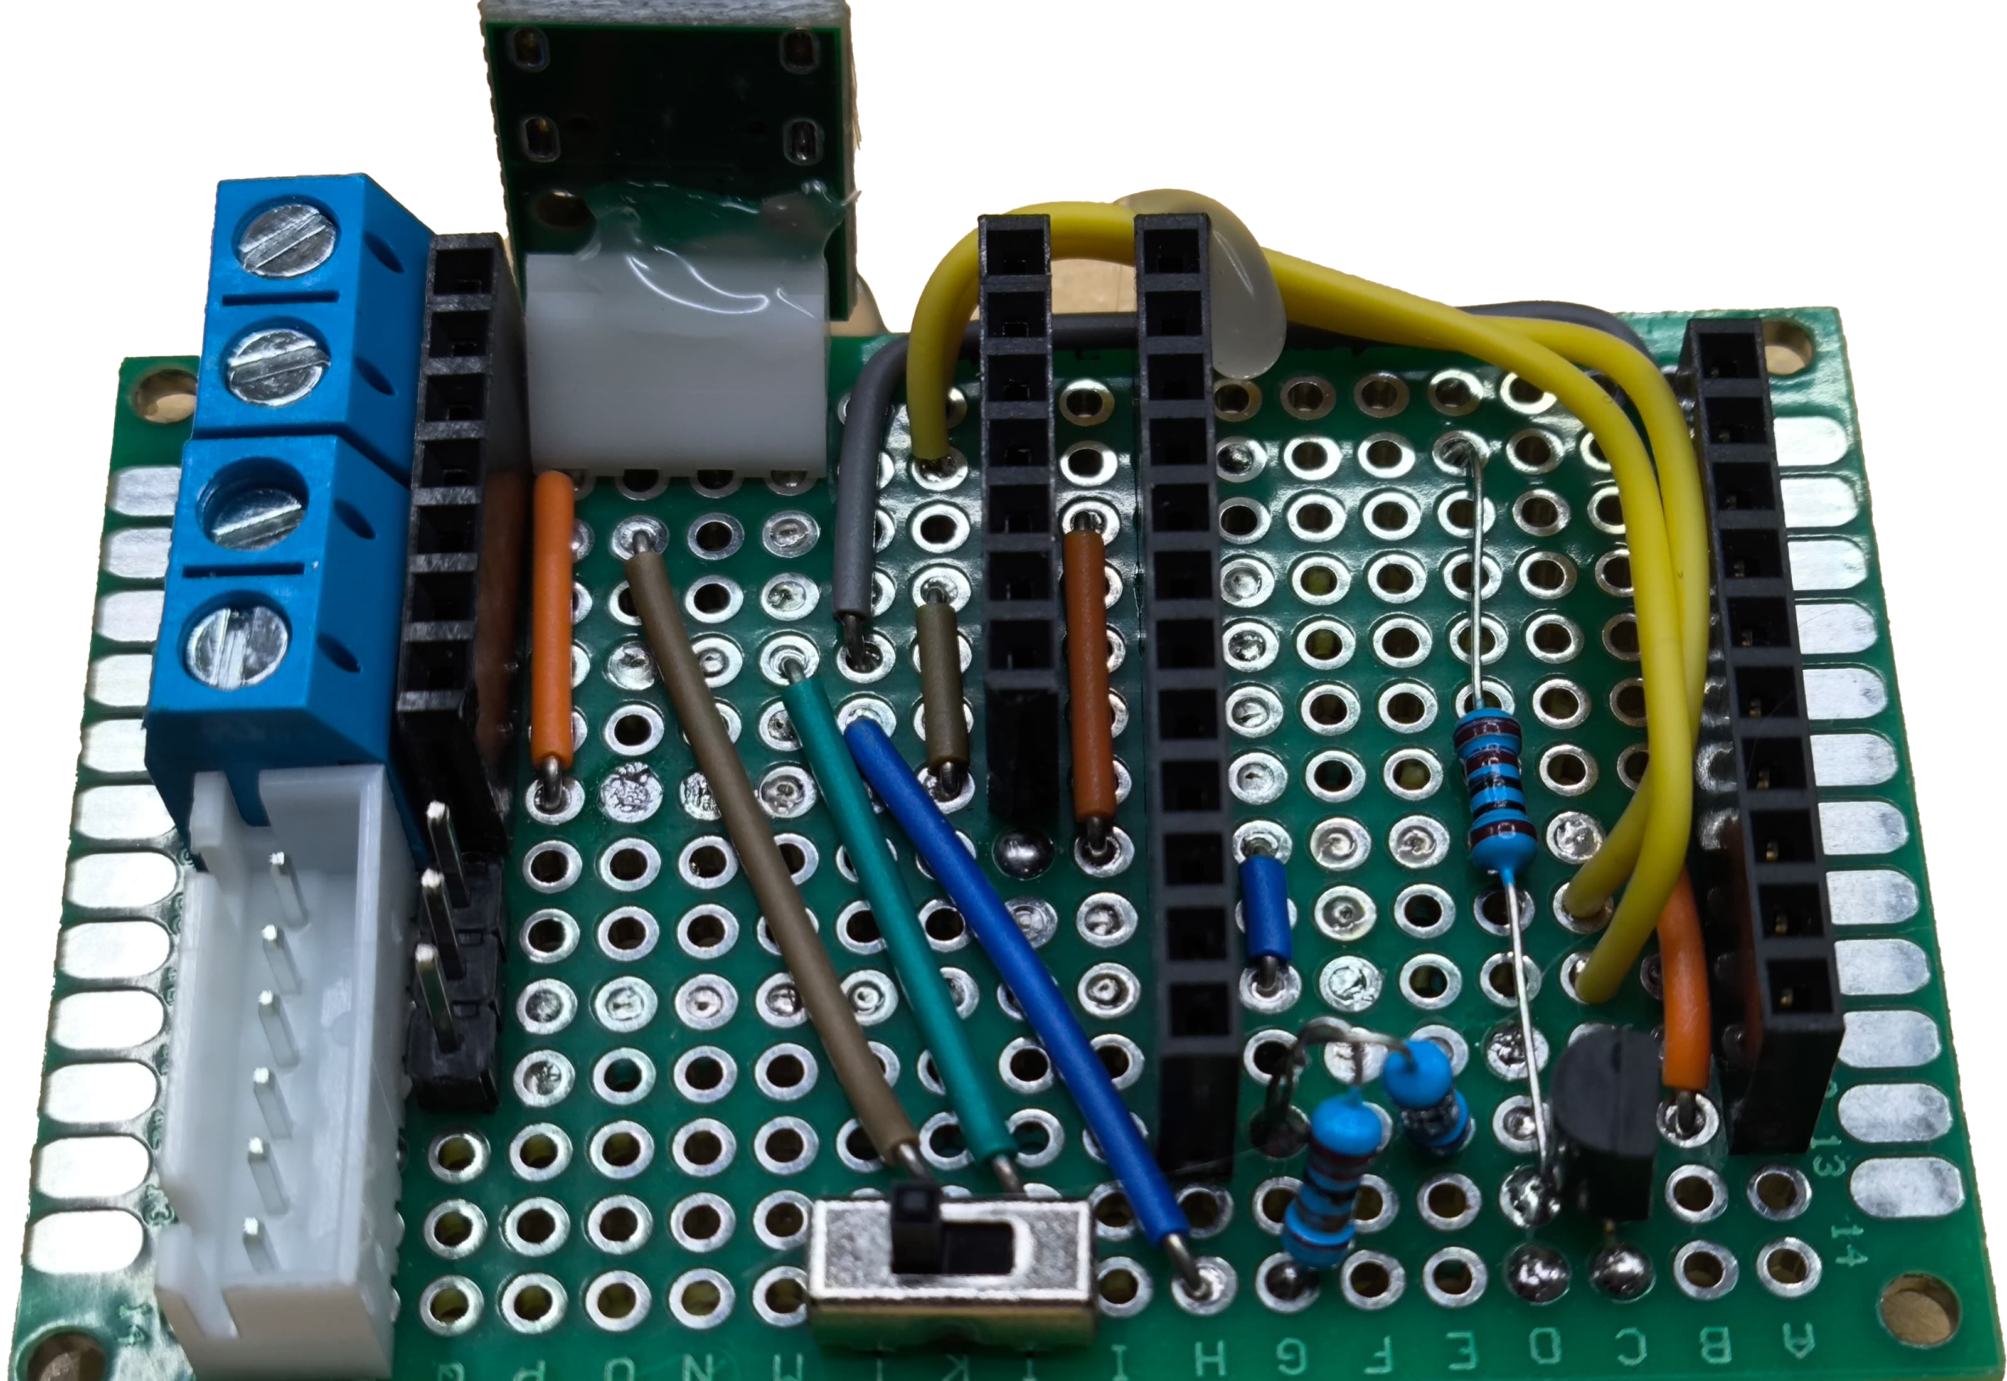
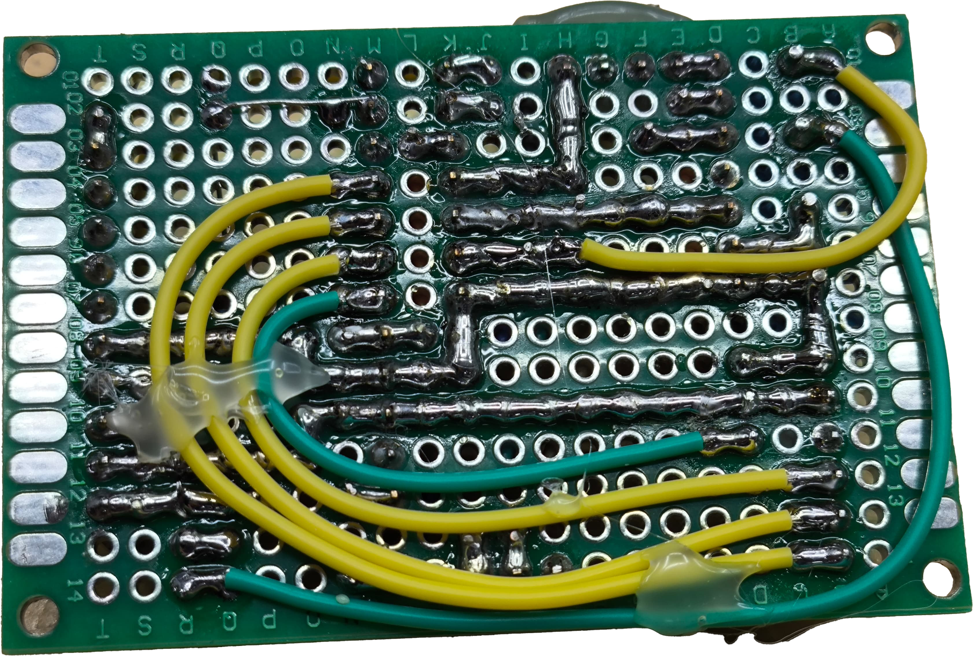
Top Layer
Resistor
Divider
Motor Control
PCB connection

Slide 7
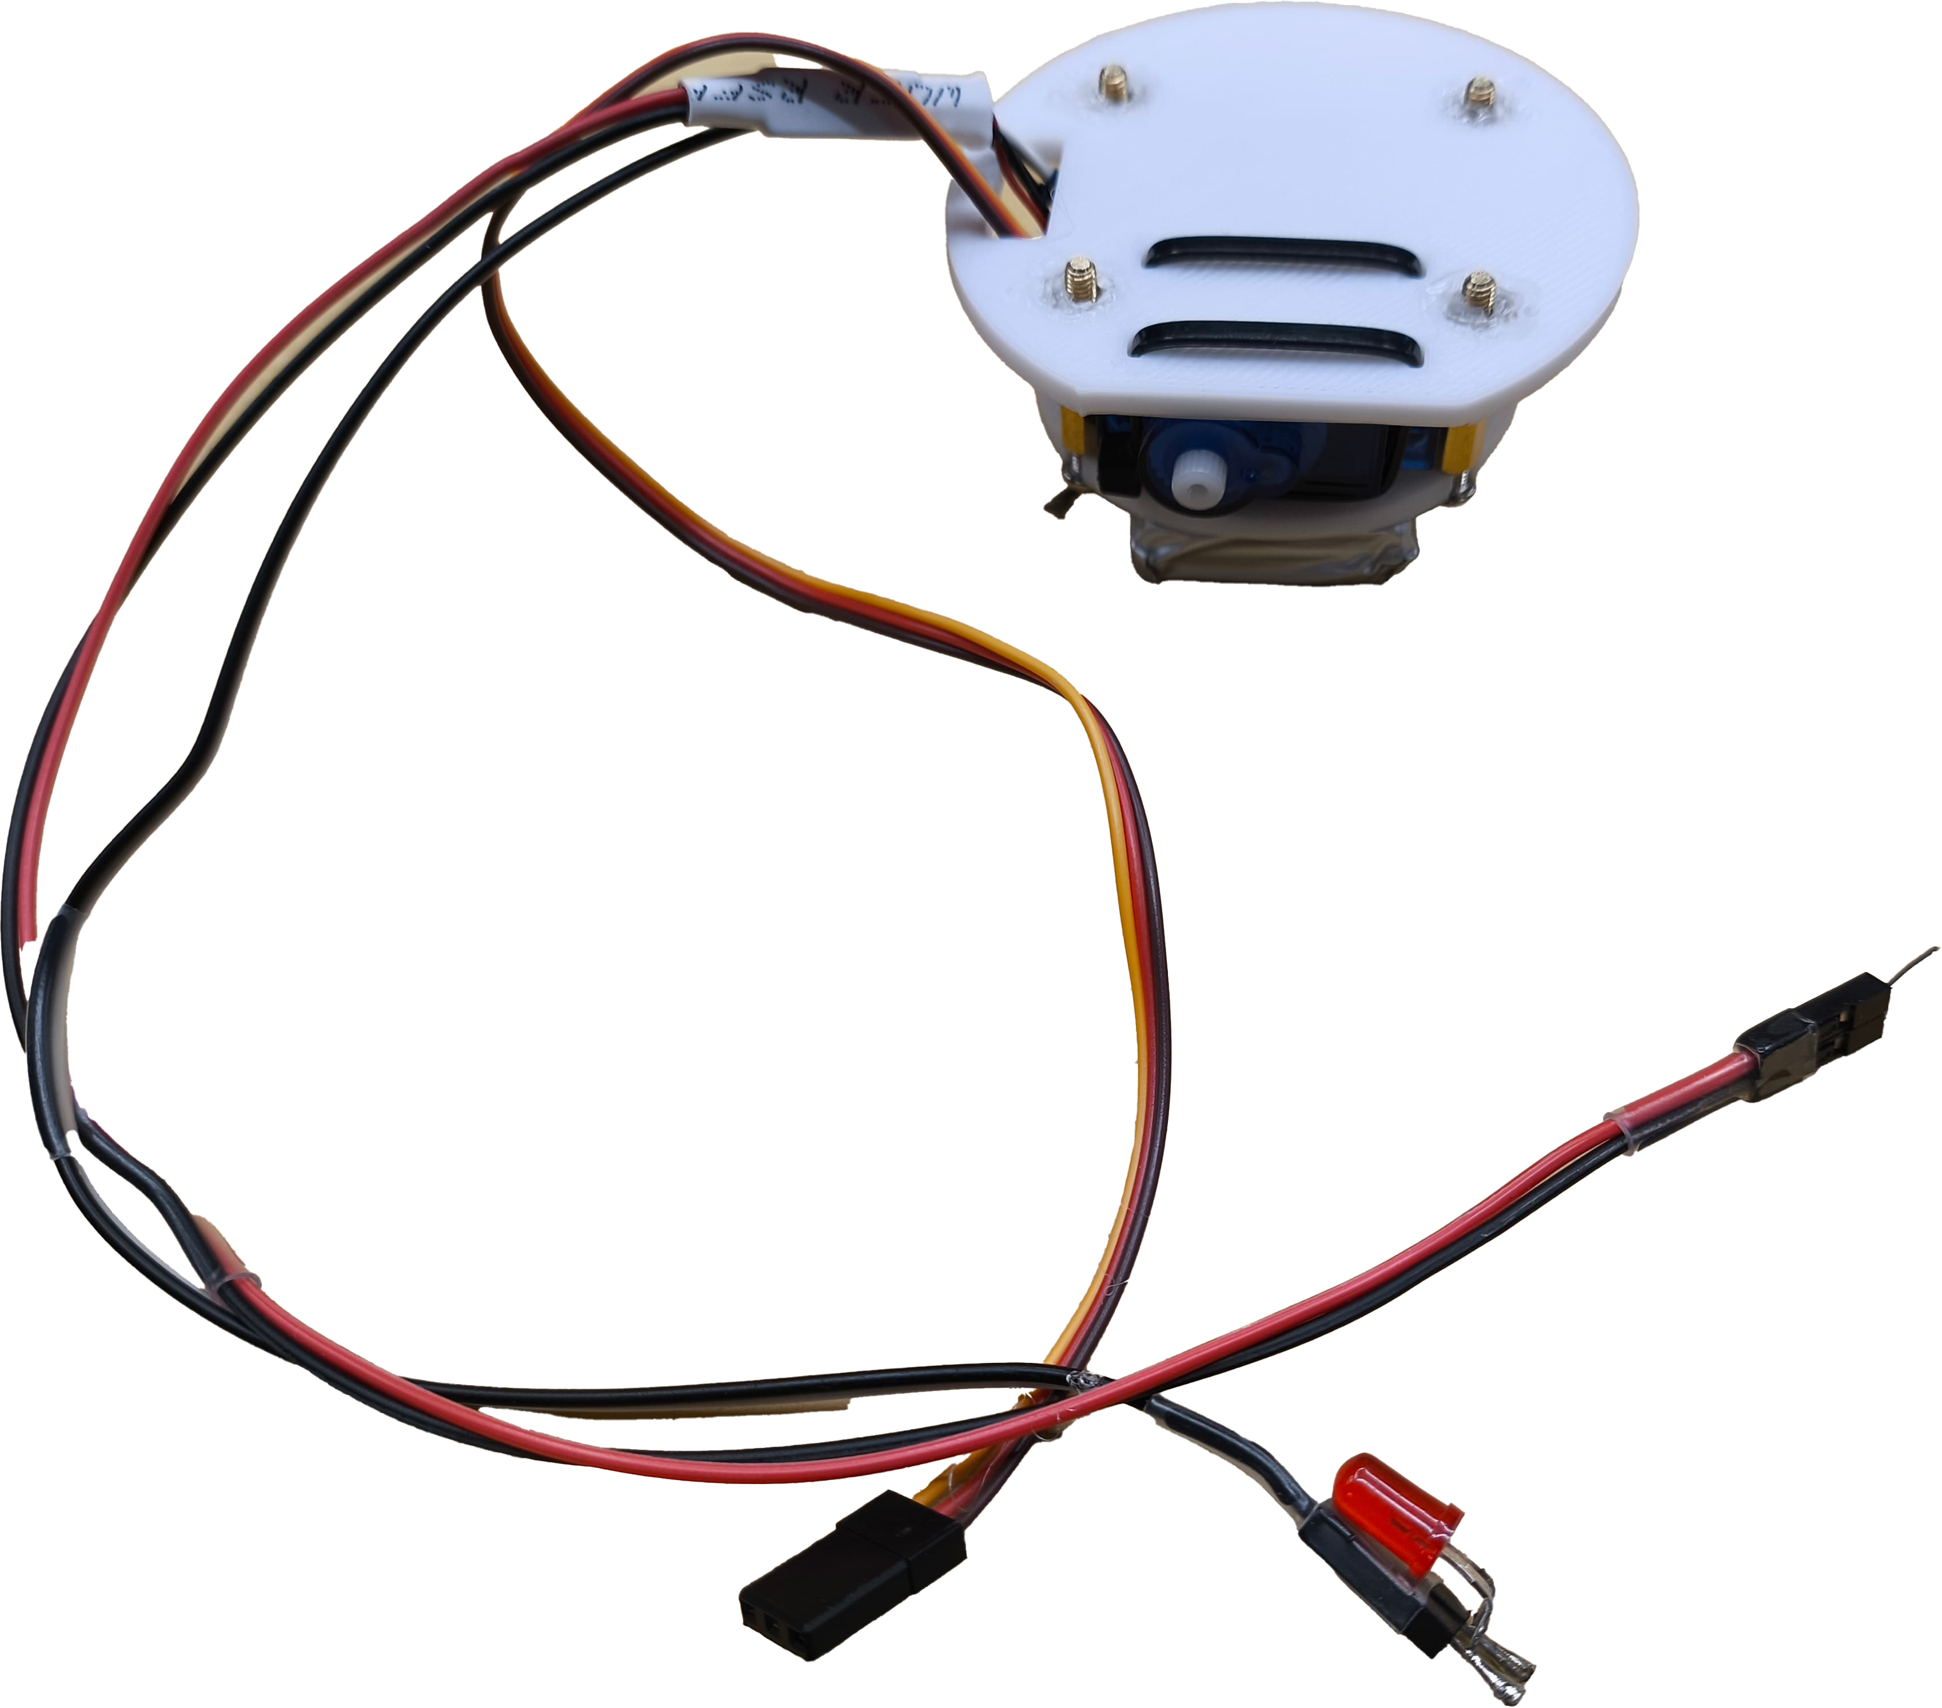
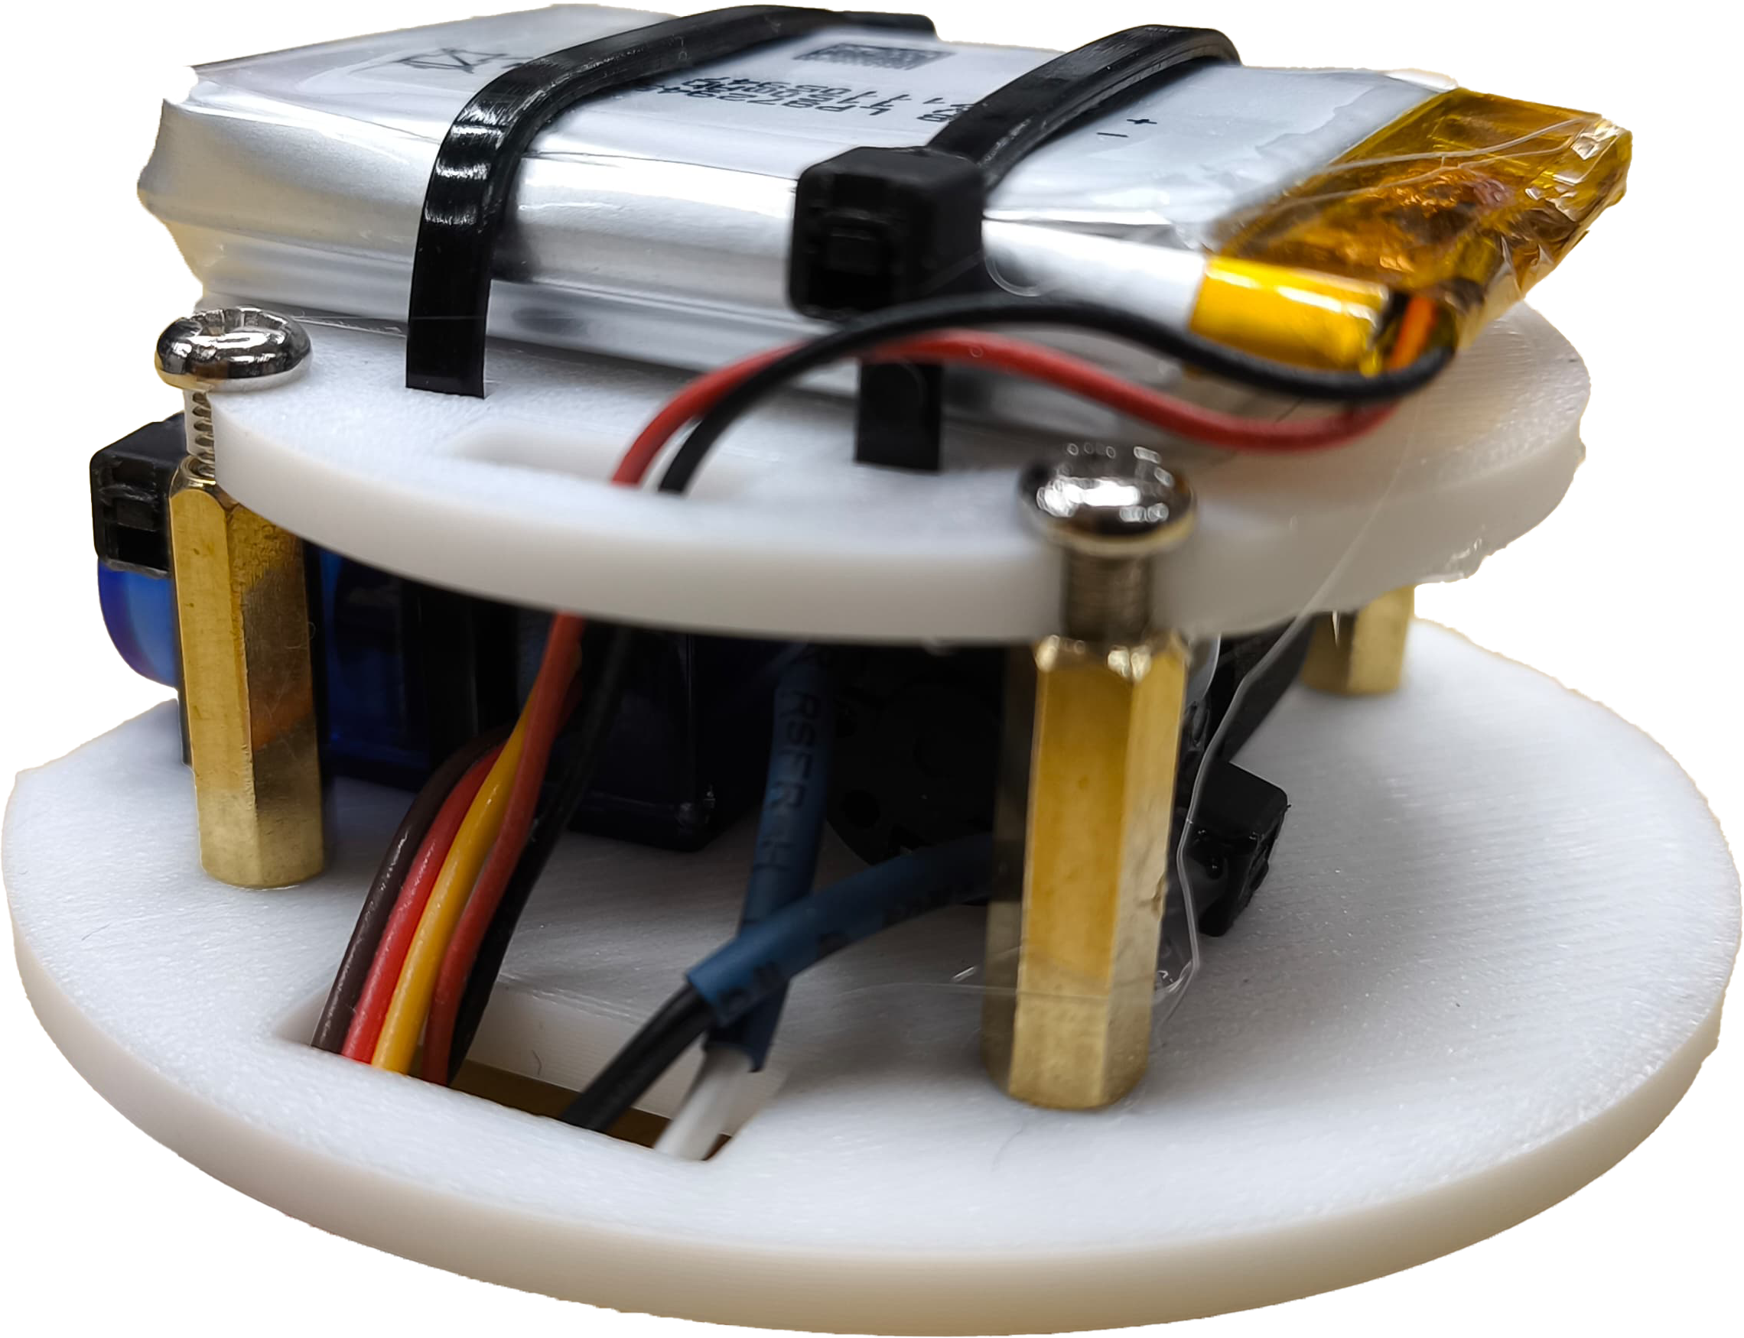
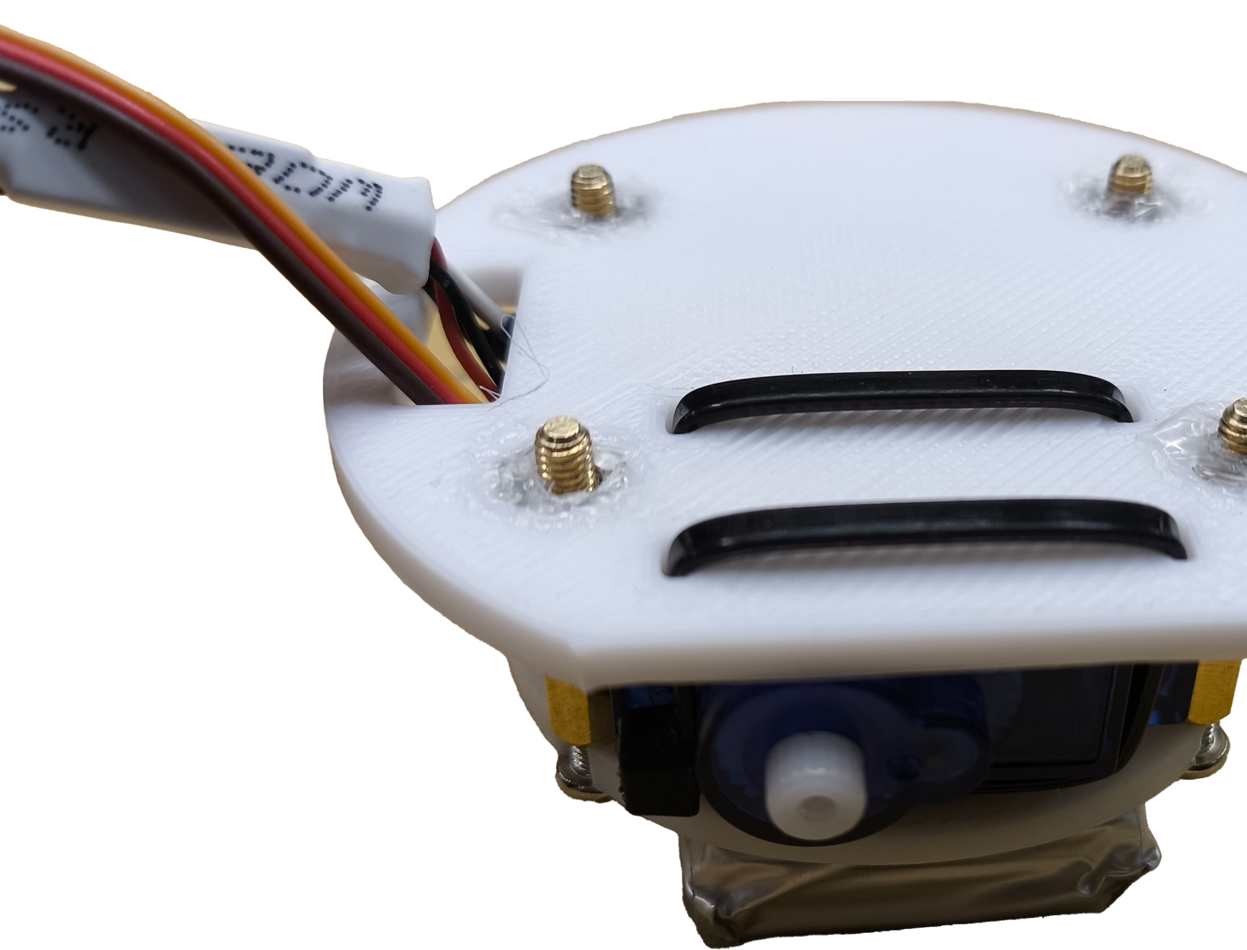
Middle Layer
Battery, servo motor, mini vibration motor

Slide 8
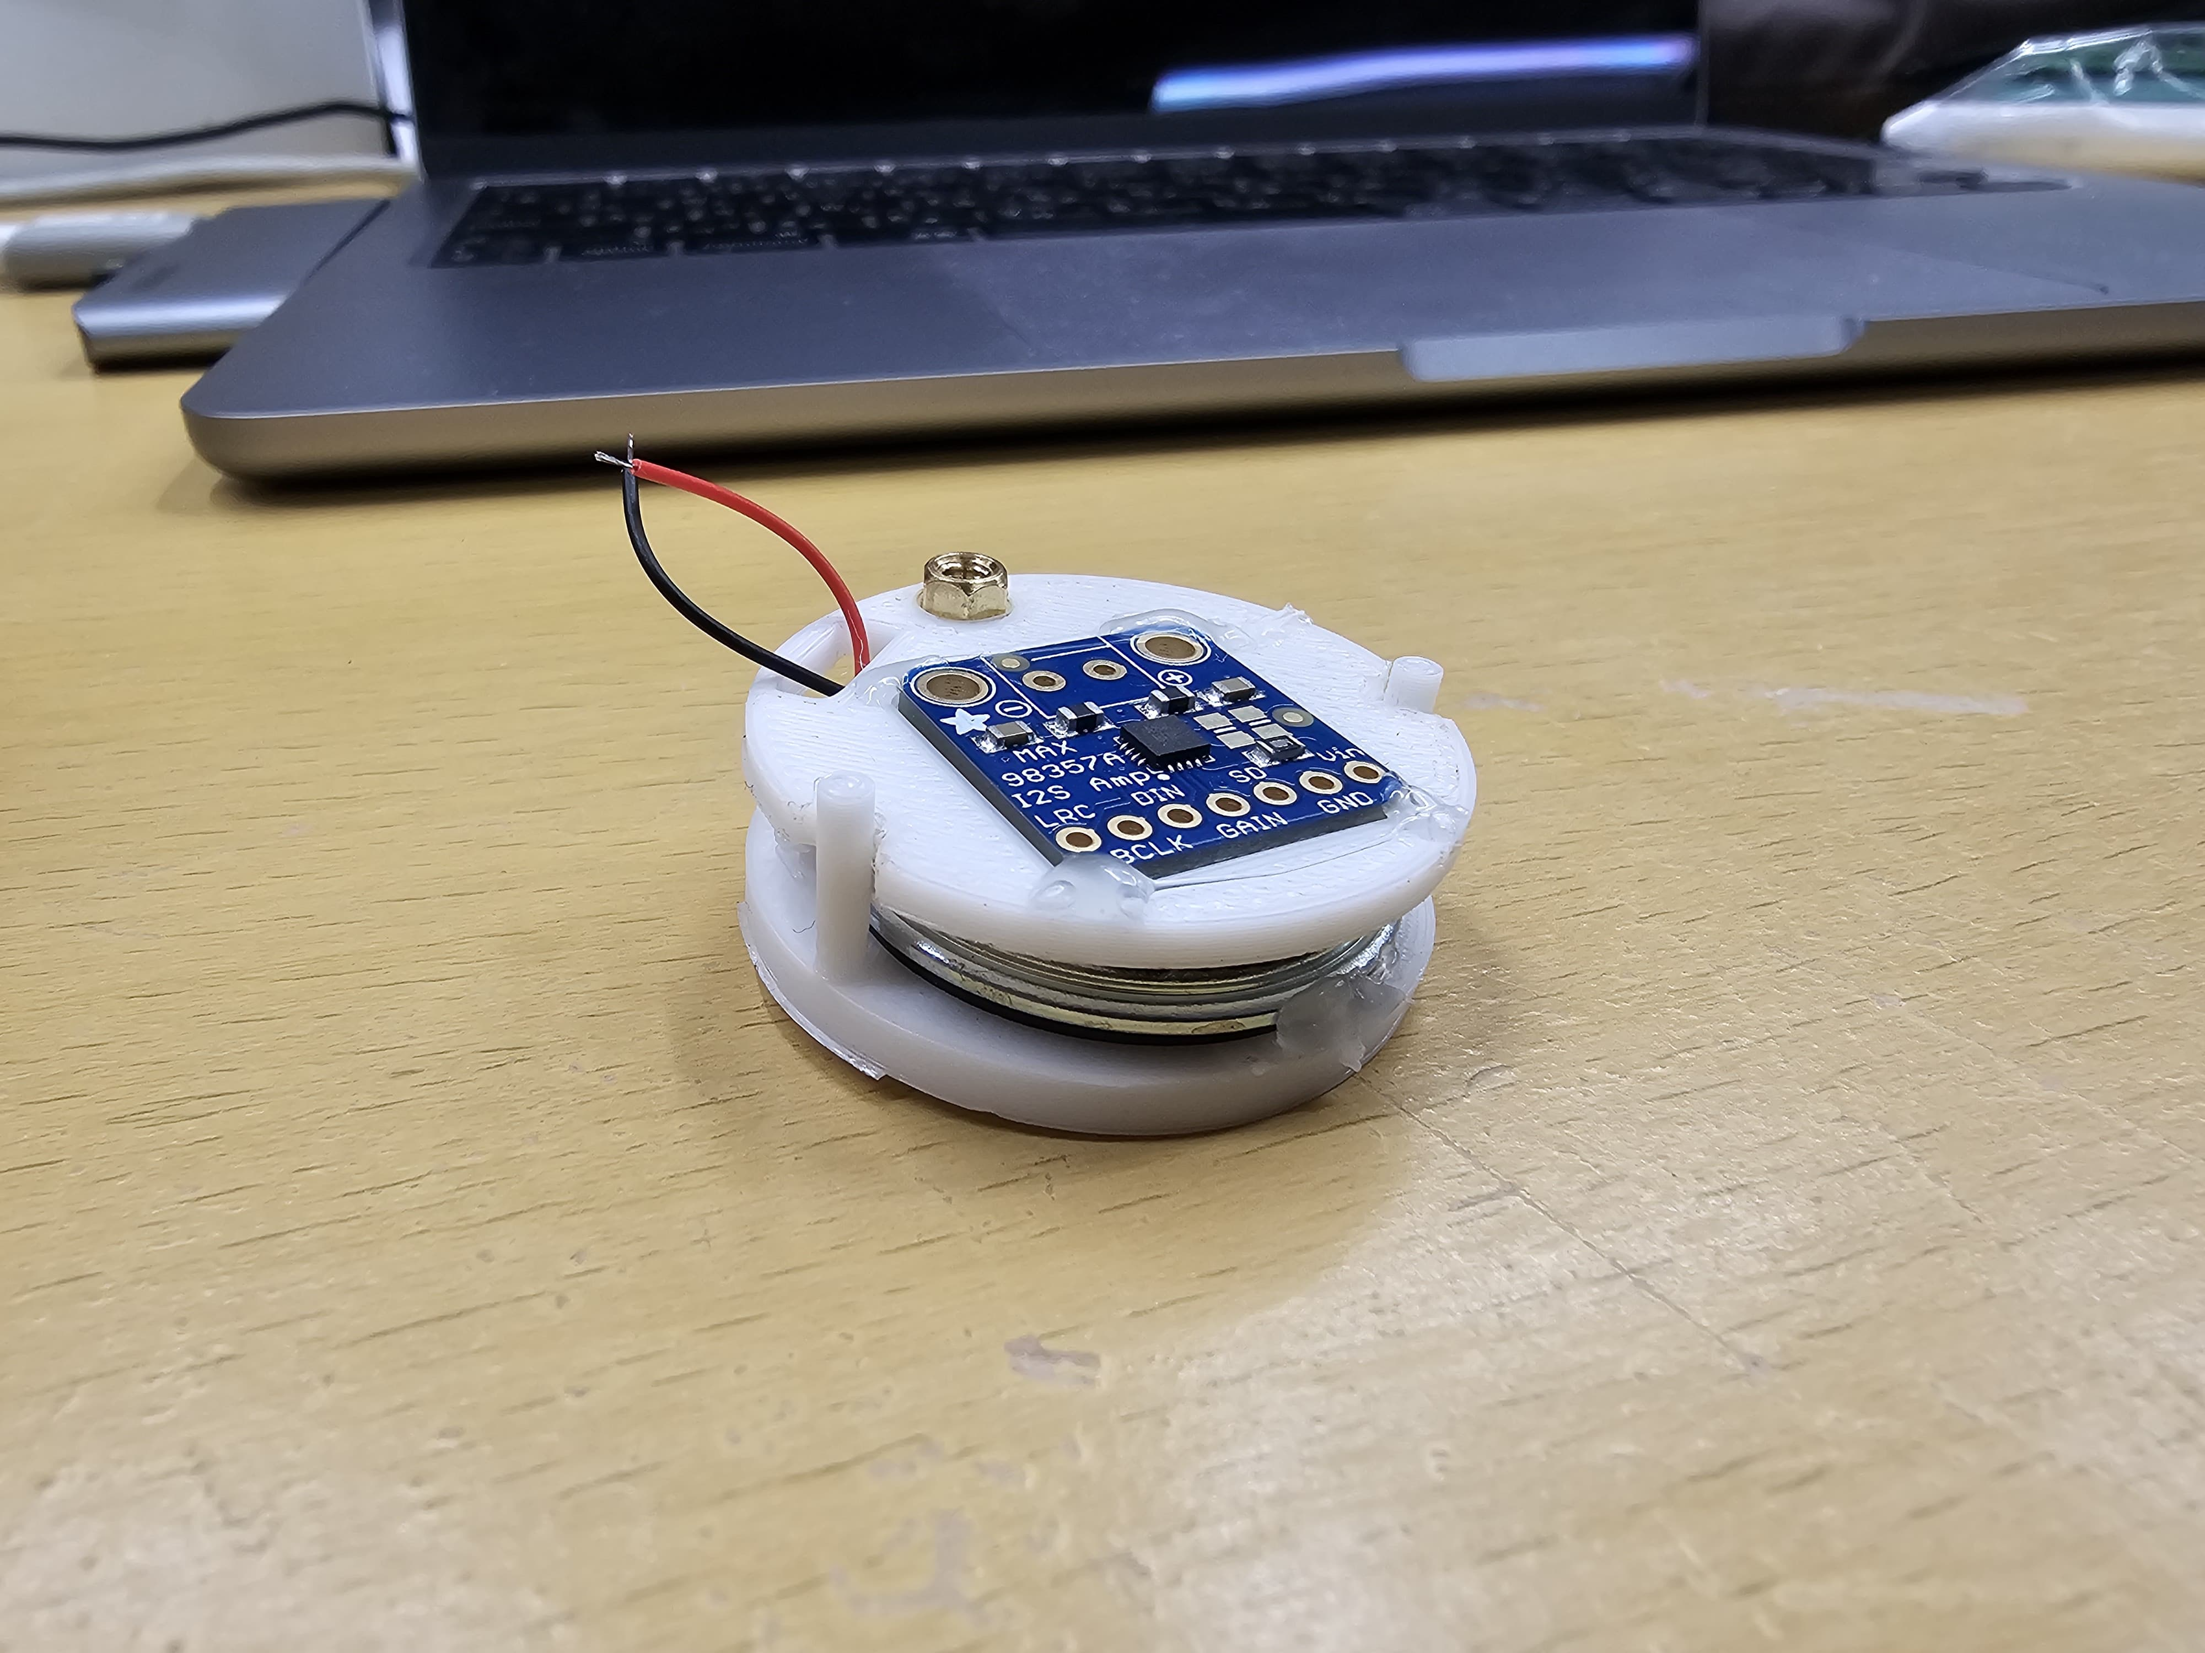
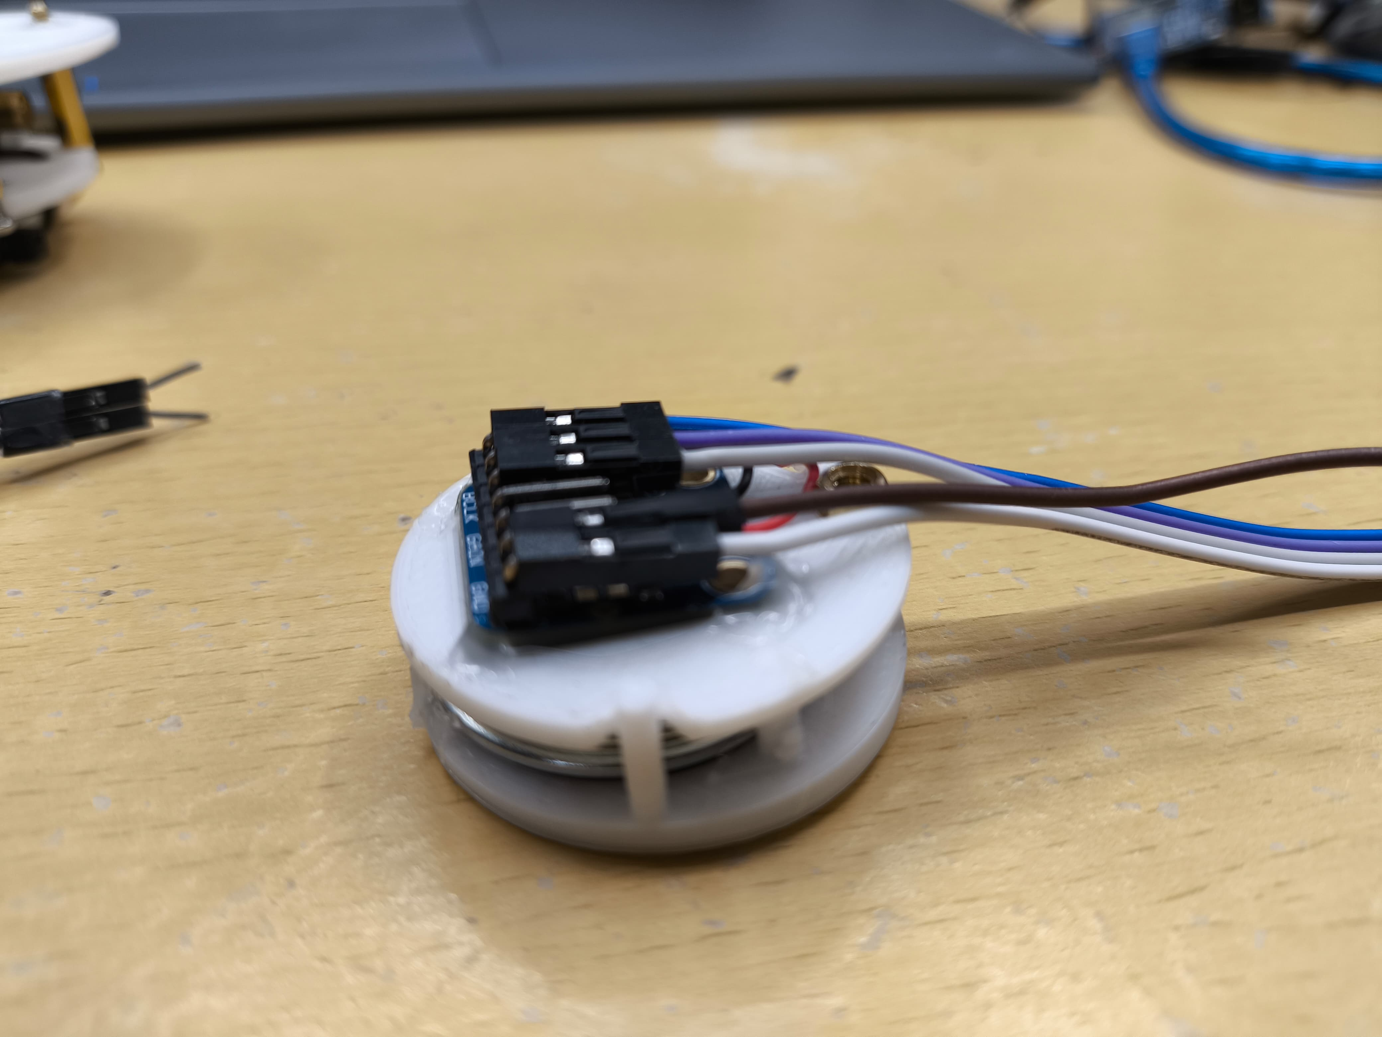
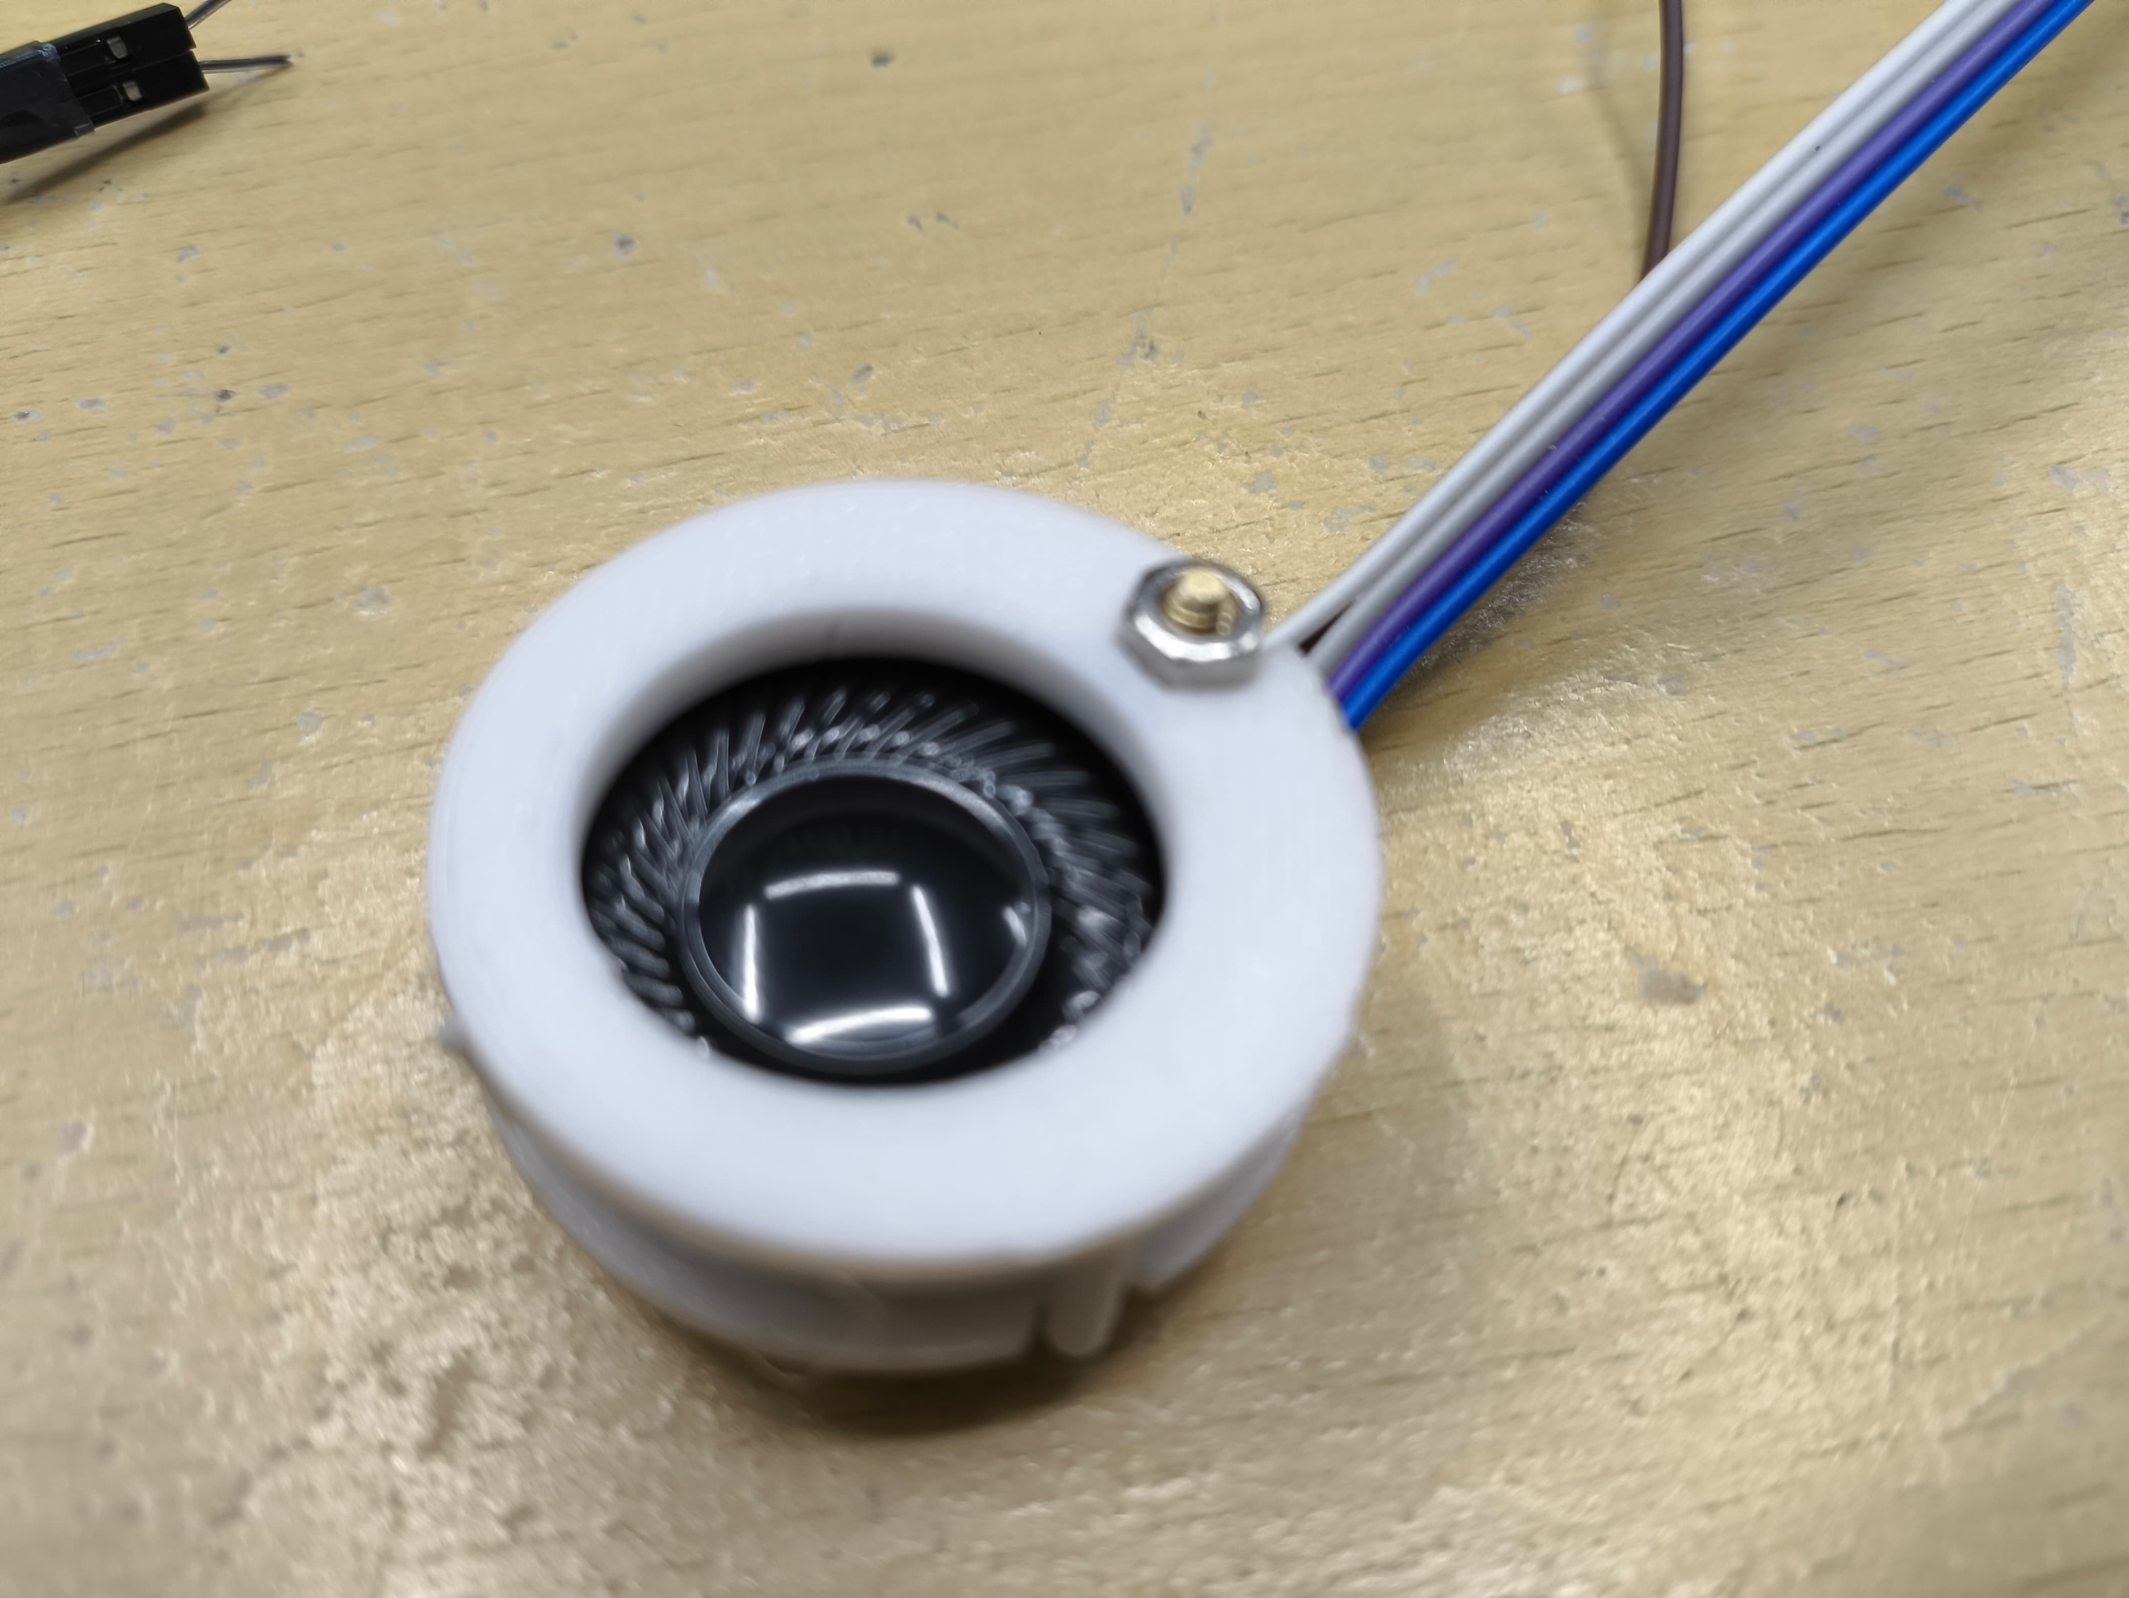
Bottom Layer
Speaker and amplifier
3d printed part

Slide 9
Troubleshooting
There is a noise from the speaker that is caused by the boost converter
Add several capacitors in the battery input and bat_out pins of the timer power module
Motor vibration should not be turned on for a long time. This can cause battery drop affecting boosting to 5v

Slide 11
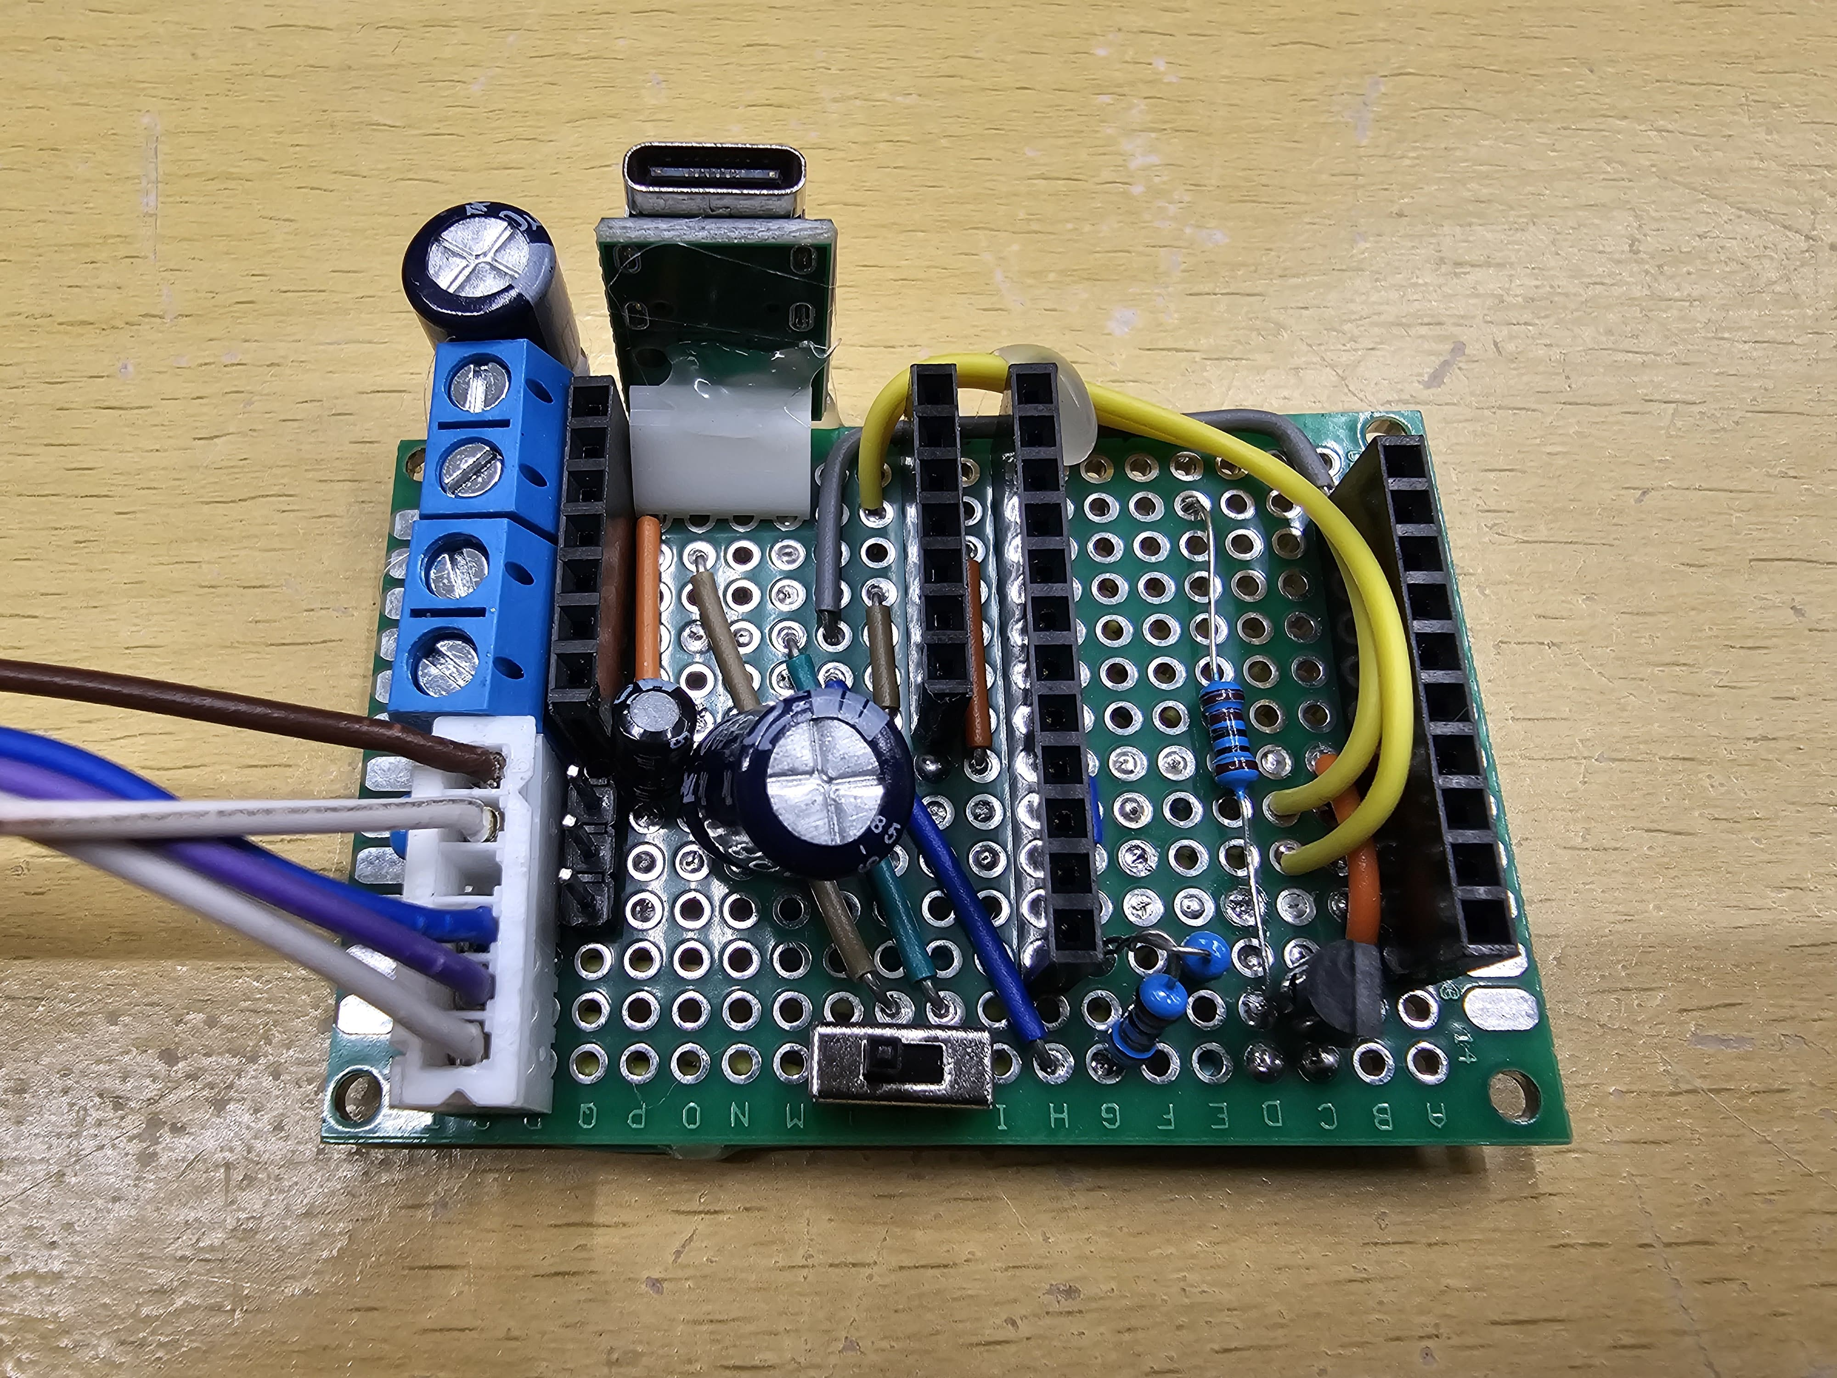
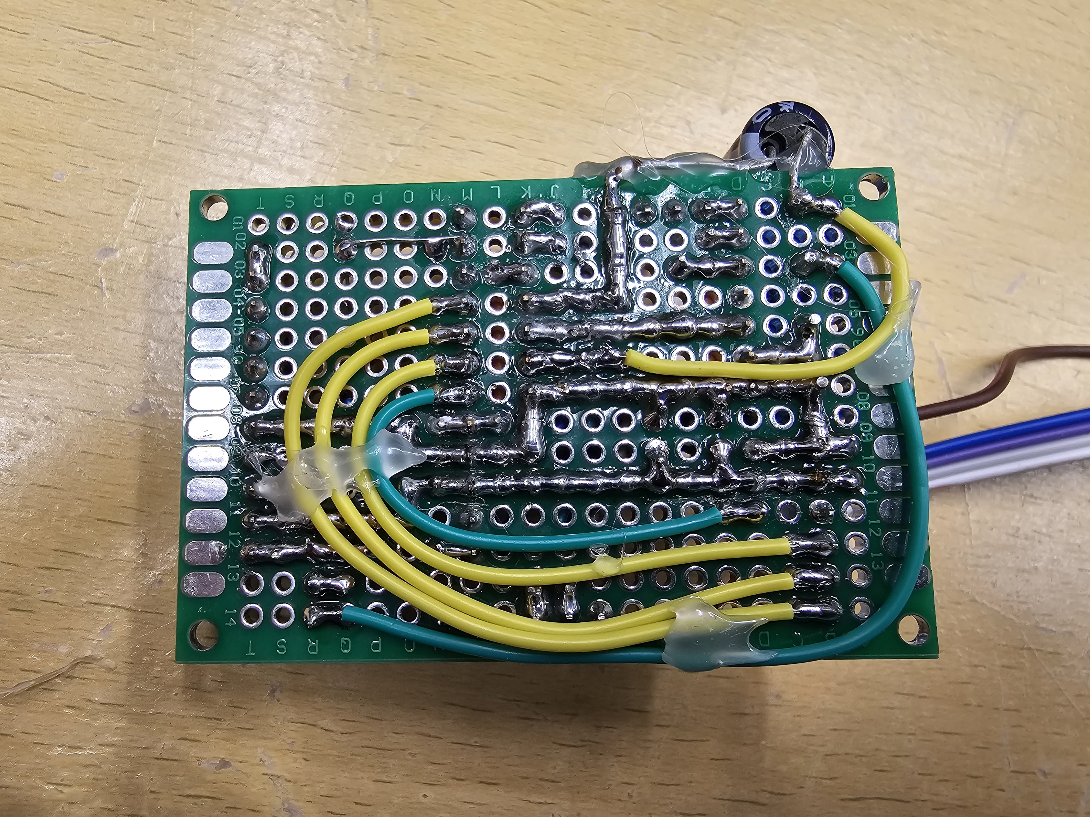
Add Filter Capacitors

Slide 12
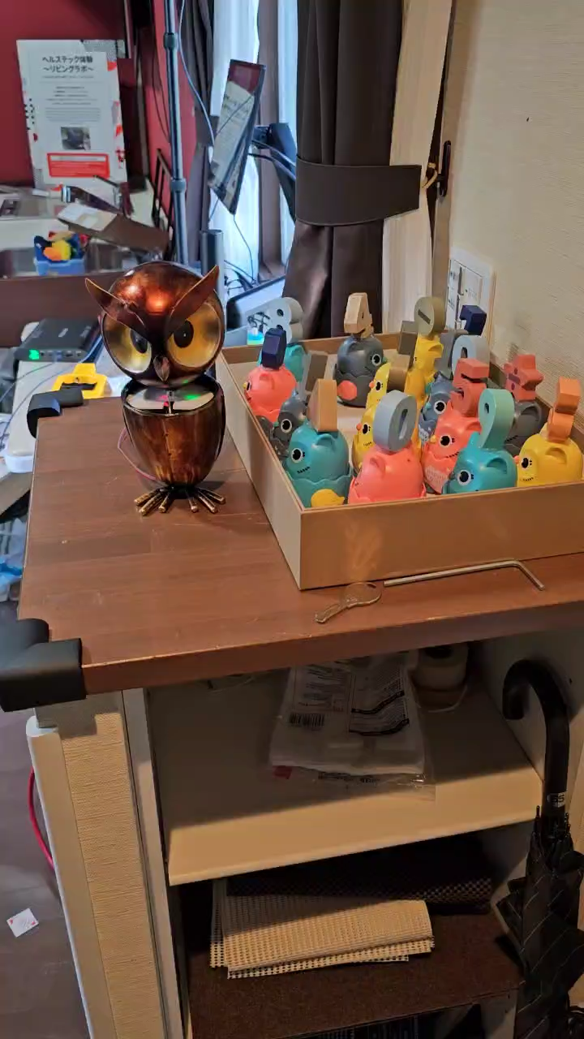
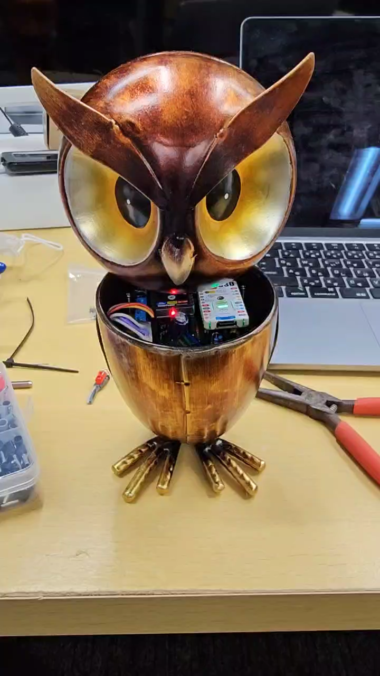
Test
Speaker is working
Vibration is working
The servo is working, but a string is still not connected to the owl’s head.
Battery cables still have to clear up
Probably add two Li-po batteries in parallel
The charging port is a bit blocked by the headstand

Slide 13
Function Expansion Tree-like Structure

Slide 14
Scenario
This owl will be put in the entrance of a trailing living life
This is when the weight, height, and face of a person are recorded
Therefore, add a small Nuc to add a speaker and a camera

Slide 15
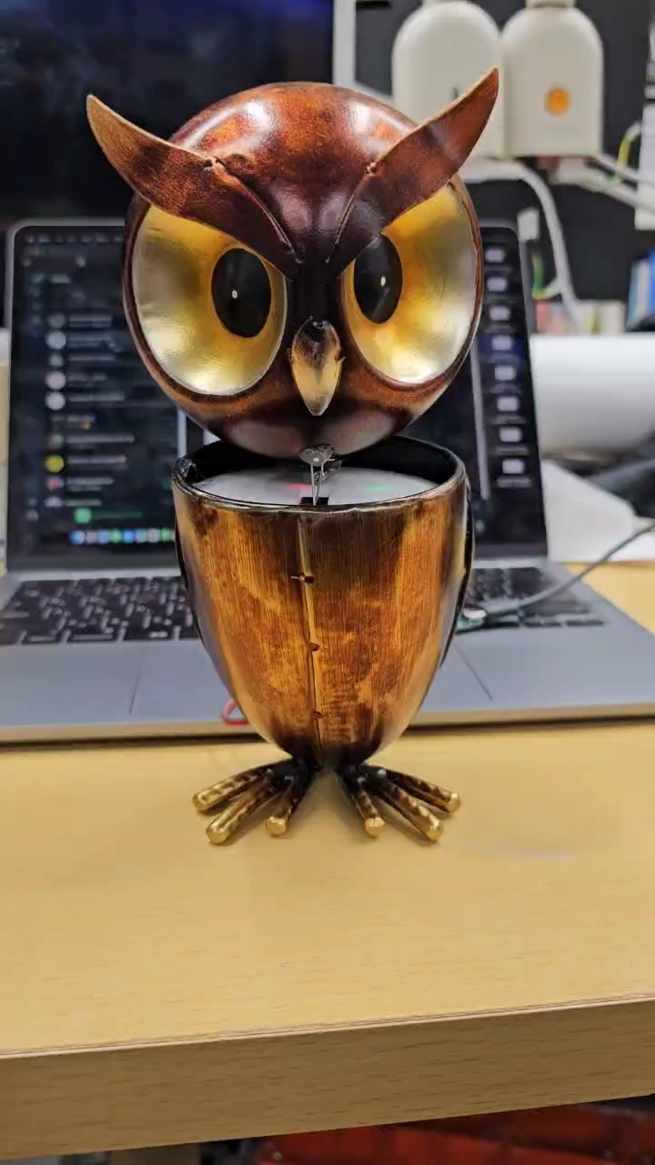
Test 2
Change the wire to the head
The wire connects servo motor to the head for nodding motion

Slide 16
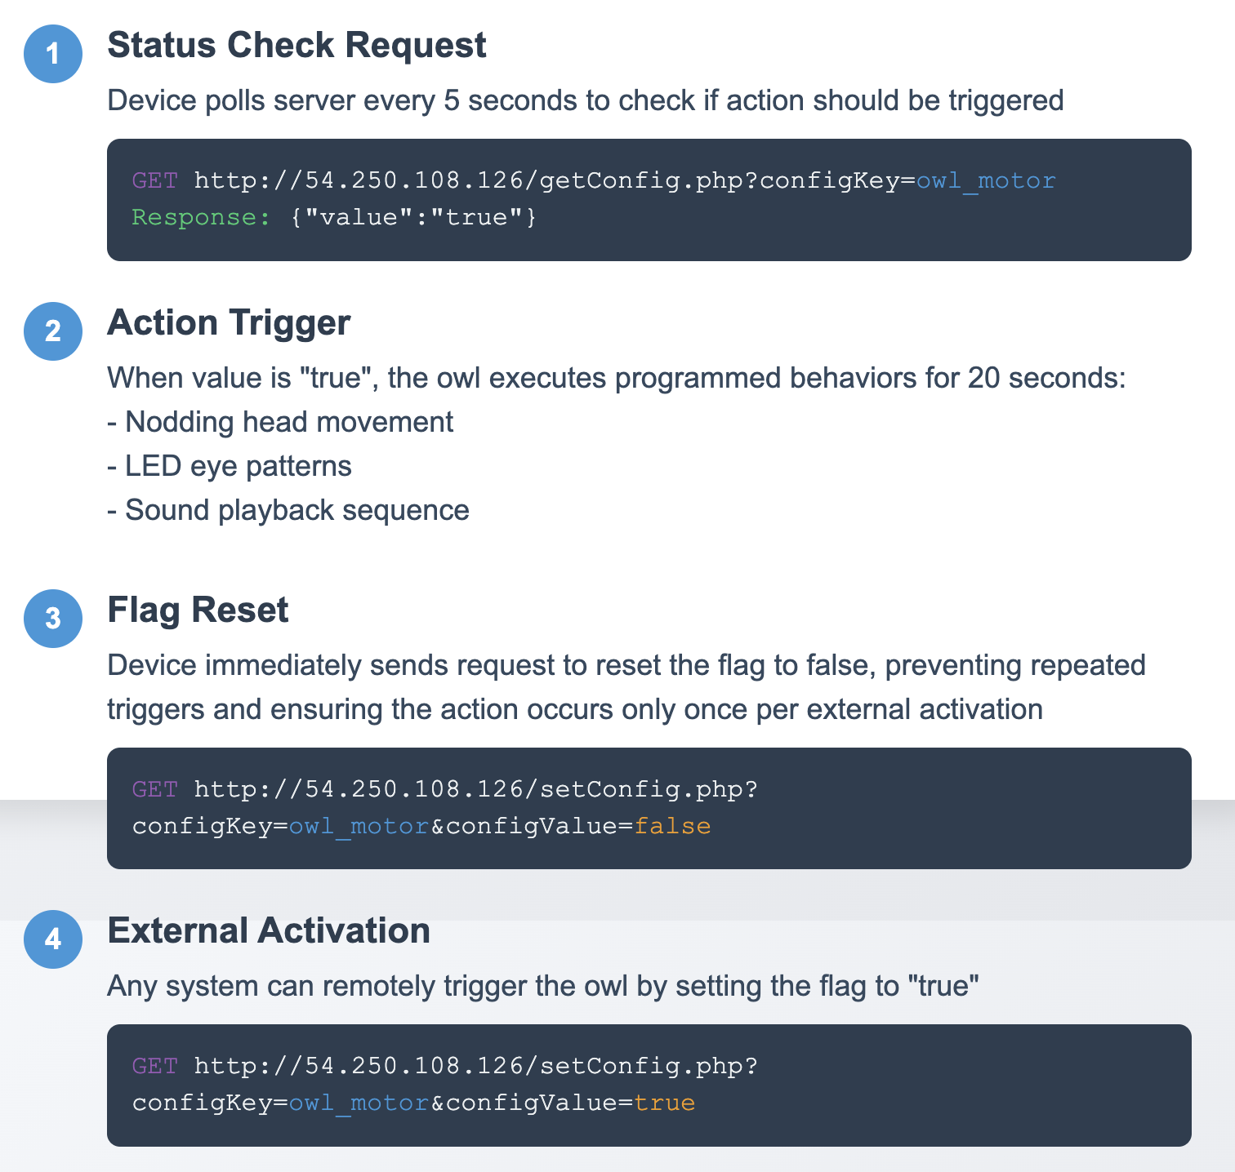
HTTP Control Process for Owl Robot

